Slide 1
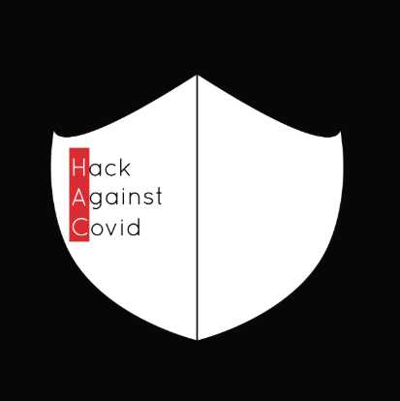
Hack Against Covid -19

Slide 2
Team Members
Aakash Soni
Mihir Sonaria
Rahul Shiyani
Dhruvi Thakrar
Devanshi Patel

Slide 3
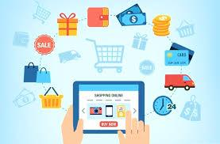
Starting An Online Buisness In Covid-19

Slide 4


THE PROBLEM / SNAG
Match People to local businesses in their neighborhood so they can find out what businesses are been done & how they can support through Covid -19.

Slide 5
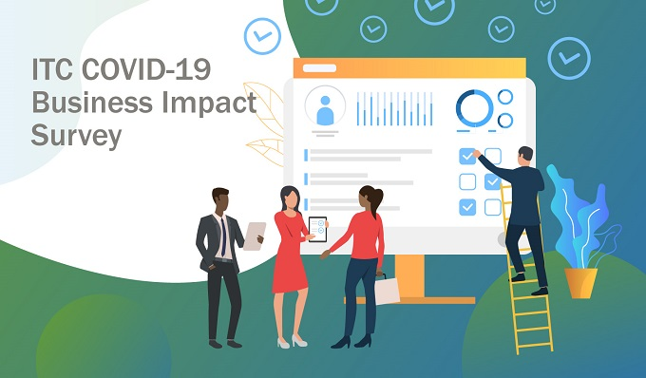
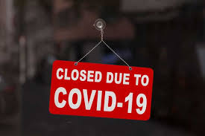
Most of the business are Shut downed.
Business activity in the services sector also fell drastically in May as the pandemic hindered operations, reduced footfall in shops and led to a decline in demand.

Slide 6
Around the globe, societies are in lockdown, and citizens are asked to respect social distance and stay at home.
The COVID-19 outbreak is likely to cause bankruptcy for many well-known brands in many industries as consumers stay at home and economies are shut.
Many companies are under enormous financial pressure. The travel industry is deeply affected; 80% of hotel rooms are empty airlines cut their workforce by 90%, and tourism destinations are likely to see no profits in 2020.
Furthermore, expos, conferences, sporting events, and other large gatherings as well as cultural establishments such as galleries and museums have been abruptly called off.
Consulting in general and personal services, like hairdressers, gyms, and taxis, have also come to a standstill due to lockdowns.

Slide 7

Solution
Building a local community finder tool for people to find local businesses/how they can provide local support to their local community.

Slide 8
This is true for a number of Internet-based businesses,such as those related to online entertainment, food delivery, online shopping, online education, and solutions for remote work.
People have also changed their consumption patterns, increasing the demand for takeout.
global access, 24 hours a day, 7 days a week
improved client service through greater flexibility
cost savings
faster delivery of products
increased professionalism
less paper waste
opportunities to manage your business from anywhere in the world.

Slide 9
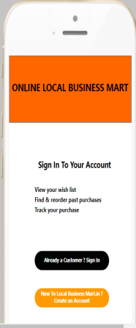
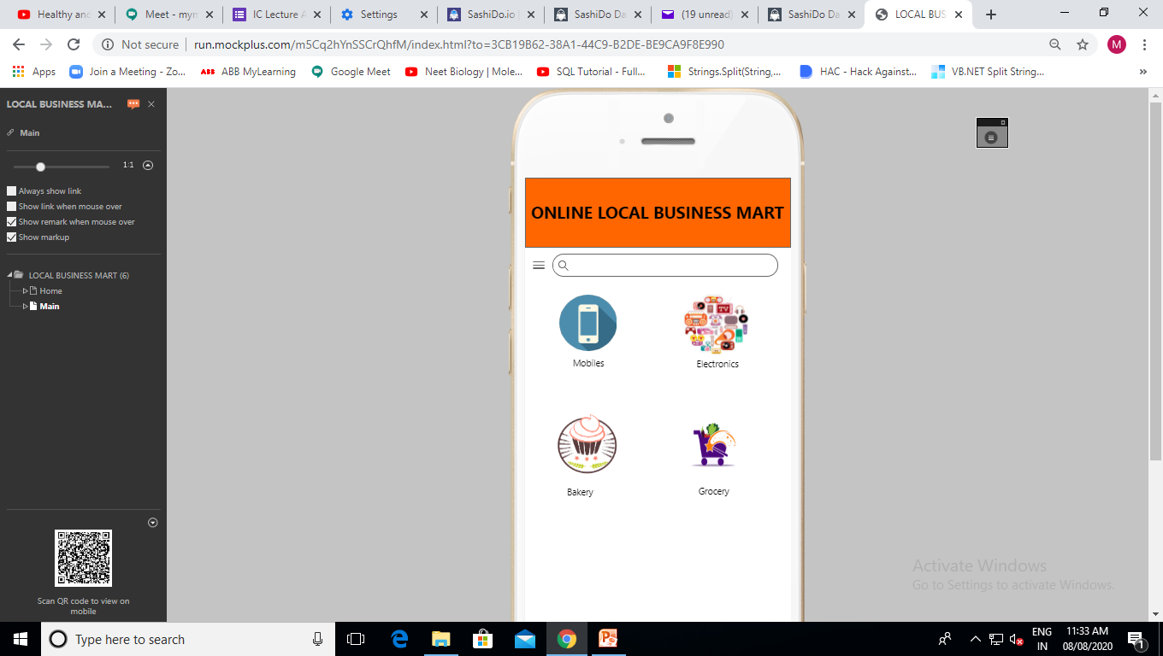
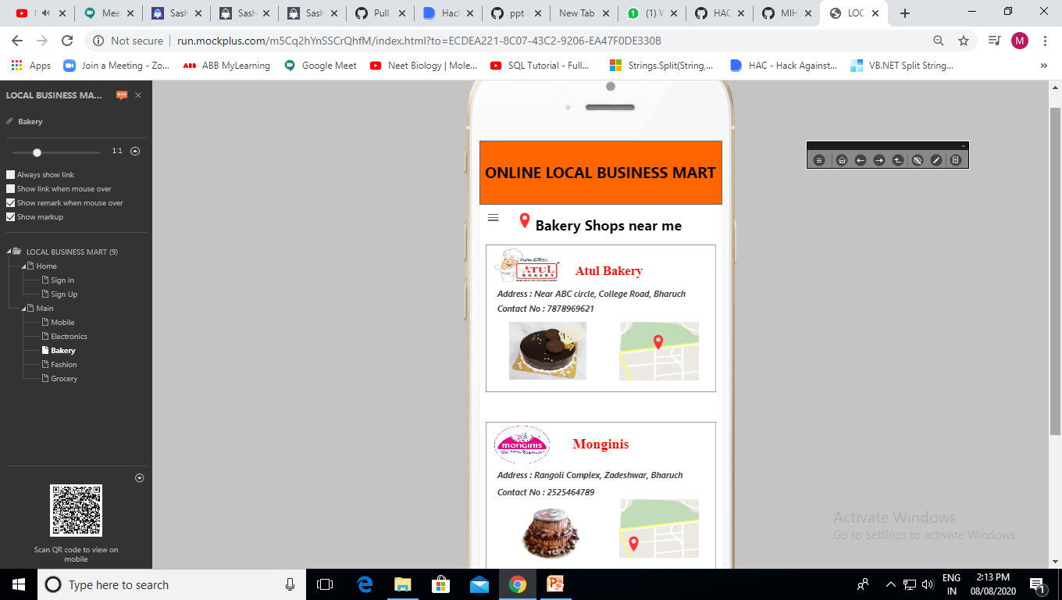
What We Can Do...
Every day, millions of people search shopping .
Our app stand out and turn those searches into
customers with the online local Business app.
Respond to reviews, message with your customers, and see your followers in the Customers tab.
Customer orders data can be seen in real time.
Different Daily uses things we provide that what makes our business app unique.
The customer review essential for the growth on right track.
Get real-time notifications to know when a customer connects with our app.
Manage multiple locations from one dashboard, and invite others to manage your listing.

Slide 10
Customers may prefer to visit your website to find out about your products and services, instead of visiting you in person. They will also expect to see your website address and your email on business cards and other promotional materials.
Online business opportunities
run an online shop
manage your suppliers
communicate with your customers, and get their feedback on your business
offer services online
allow customers to make reservations or appointments online
manage your finances, such as online banking, tax and employee pay
research competitors.

Slide 11
Future opportunities
research your competitors and other businesses that use online tools
decide what aspects of online business will benefit your business
review your budget to work out what you can afford
familiarise yourself with any laws and regulations that will apply to your online business activities
consider your requirements, including what software you need and what types of computer equipment you need to run it
plan for risks, such as computer viruses, scams, data theft and loss of or damage to hardware
think about what training you or your staff might need
be realistic about the time and budget you will need to manage the online aspects of your business.

Slide 12
Conclusions
A Strategy Should often be kept relatively simple
Success relies on gaining understanding, acceptance and support by people within the company.
The strategy must accomplish it objectives by providing direct or indirect value to customers.
Information System Can only be successful if it supports the right business strategies.

Slide 13


